Slide 1
Stochastic model of order book
Potential for High frequency trading applications
Chung, Dahan, Hocquet, Kim
MS&E 444, Stanford University, June 2009

Slide 2
Our approach
Studying the model proposed by Cont et al.
Computing interesting probabilities through different methods: Laplace transform, order book simulator
Trying to apply these results to algorithmic trading strategies
MS&E 444 Stochastic model of order book

Slide 3
Assessment of the model
Orders and cancellations are independent and arrive at exponential times
Comparison to empirical facts [1]:
  Microstructure noise
  Negative lag-1 autocorrelation
  Long-term shape of the order book
  Distribution of the durations
  Hurst coefficient > 0.5
[1] F. Slanina, Critical comparison of several order-book models for stock-market fluctuations, The European Physical Journal B - Condensed Matter and Complex Systems,, Volume 61, Issue 2, 225-240, 2008-01-01
MS&E 444 Stochastic model of order book

Slide 4
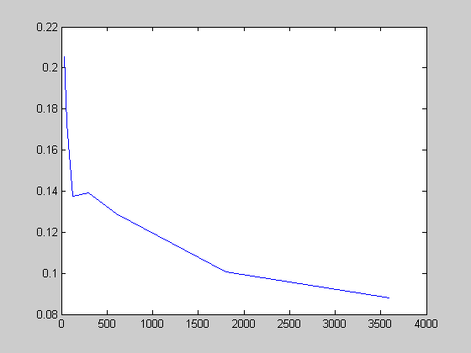
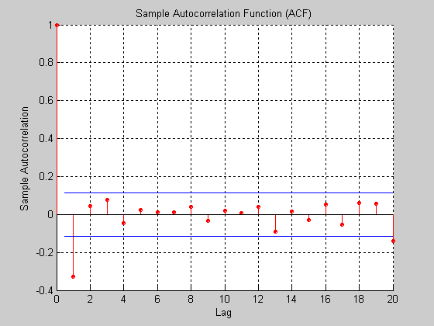
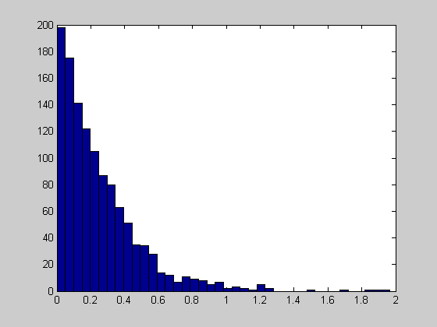
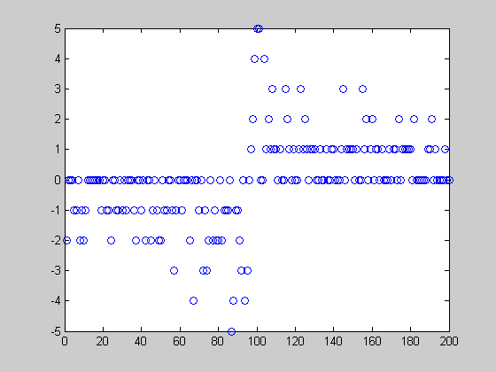
Volatility as a function of the sampling frequency
Autocorrelation function
Distribution of durations
Long-term shape of the order book

Slide 5
Interesting probabilities and strategies
Conditional probability that the mid-price increases during the next 1,2…10 price changes
Conditional probability to execute an order before the mid-price moves
Conditional probability to make the spread
Examples of related strategies
MS&E 444 Stochastic model of order book

Slide 6
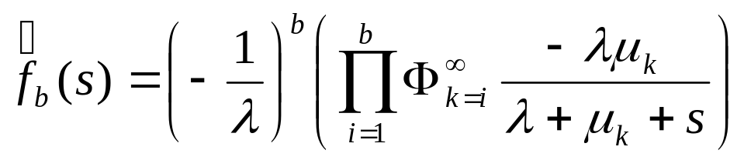
Inverse Laplace transform
A recurrence relation for a birth-death process allows us to express the Laplace transform of the first passage time as a continued fraction (CF) [Abate 1999]
Probabilities of interest can be expressed as a function of the inverse Laplace transform of the CF
Numerically computing the inverse is fast (No need to find the whole function)
MS&E 444 Stochastic model of order book

Slide 7
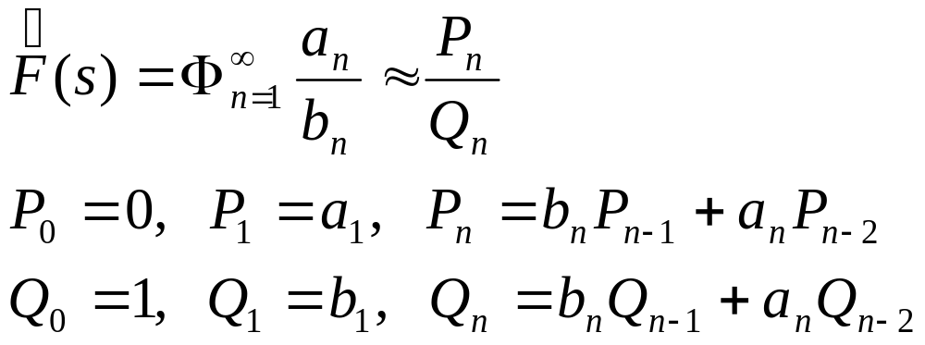
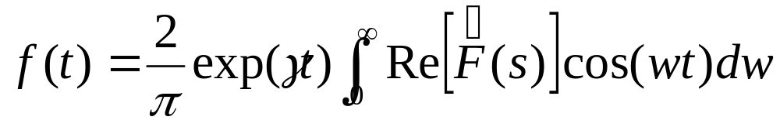
Numerical methods
Rational approximation of CF [Euler 1737]
A Fourier series method for approximating Bromwich integral [Abate 1993]
Pade approximation for acceleration of convergence [Longman 1973, Luke 1962]
MS&E 444 Stochastic model of order book

Slide 8
Probability of increase in mid price
My order is b_{th} order at the bid
Number of orders at the ask is a
Probability that the mid-price increases
An example, when spread = 1
Monte-carlo simulation
Laplace inversion
 | 1 | 2 | 3 | 4 | 5
1 | 0.5057 | 0.3344 | 0.2622 | 0.2466 | 0.202
2 | 0.675 | 0.508 | 0.4218 | 0.351 | 0.3051
3 | 0.7477 | 0.609 | 0.5084 | 0.4321 | 0.3859
4 | 0.7844 | 0.647 | 0.5878 | 0.5479 | 0.4851
5 | 0.7973 | 0.6698 | 0.6099 | 0.5736 | 0.5288
 | 1 | 2 | 3 | 4 | 5
1 | 0.5000 | 0.3368 | 0.2615 | 0.2188 | 0.1912
2 | 0.6637 | 0.5003 | 0.4085 | 0.3504 | 0.3105
3 | 0.7392 | 0.5922 | 0.5003 | 0.4380 | 0.3930
4 | 0.7819 | 0.6503 | 0.5627 | 0.5003 | 0.4537
5 | 0.8096 | 0.6903 | 0.6078 | 0.5470 | 0.5004
MS&E 444 Stochastic model of order book

Slide 9
Probability of increase in mid price after several price changes
10 price changes
 | 1 | 2 | 3 | 4 | 5
1 | 0.5291 | 0.4927 | 0.4868 | 0.4735 | 0.454
2 | 0.5627 | 0.5321 | 0.5168 | 0.4938 | 0.4705
3 | 0.5735 | 0.5531 | 0.5336 | 0.4914 | 0.5182
4 | 0.5743 | 0.5507 | 0.5675 | 0.5442 | 0.531
5 | 0.5744 | 0.5351 | 0.5674 | 0.5593 | 0.4531
2 price changes
 | 1 | 2 | 3 | 4 | 5
1 | 0.554 | 0.4631 | 0.3982 | 0.3757 | 0.3454
2 | 0.6385 | 0.5568 | 0.4893 | 0.4446 | 0.3994
3 | 0.6845 | 0.614 | 0.5384 | 0.5019 | 0.4593
4 | 0.7226 | 0.6467 | 0.5976 | 0.5771 | 0.5024
5 | 0.7299 | 0.6681 | 0.6037 | 0.5745 | 0.5706

Slide 10
Probability of executing a limit order
My order is b_{th} order at the bid
Number of orders at the ask is a
Probability that my order is executed before the ask price moves
An example, when spread = 1
Monte-carlo simulation
Laplace inversion
 | 1 | 2 | 3 | 4 | 5
1 | 0.6159 | 0.7829 | 0.8550 | 0.8995 | 0.9220
2 | 0.4702 | 0.6622 | 0.7563 | 0.8086 | 0.8486
3 | 0.3966 | 0.5799 | 0.6779 | 0.7440 | 0.7851
4 | 0.3593 | 0.5184 | 0.6161 | 0.6869 | 0.7433
5 | 0.3198 | 0.4724 | 0.5738 | 0.6450 | 0.6965
 | 1 | 2 | 3 | 4 | 5
1 | 0.5081 | 0.7038 | 0.7992 | 0.8531 | 0.8866
2 | 0.3665 | 0.5595 | 0.6726 | 0.7448 | 0.7939
3 | 0.2998 | 0.4756 | 0.5886 | 0.6661 | 0.7218
4 | 0.2602 | 0.4203 | 0.5288 | 0.6066 | 0.6648
5 | 0.2332 | 0.3807 | 0.4838 | 0.5601 | 0.6187
MS&E 444 Stochastic model of order book

Slide 11
Probability of the making the spread
My order is b_{th} order at the bid
My order is a_{th} order at the ask
Probability that both orders are executed before the mid price moves
An example, when spread = 1
Monte-carlo simulation
Laplace inversion
 | 1 | 2 | 3 | 4 | 5
1 | 0.2771 | 0.3249 | 0.3219 | 0.3095 | 0.3029
2 | 0.3193 | 0.3985 | 0.4223 | 0.4253 | 0.4175
3 | 0.3145 | 0.4179 | 0.4458 | 0.4657 | 0.4582
4 | 0.3136 | 0.4248 | 0.4686 | 0.485 | 0.4913
5 | 0.3024 | 0.4204 | 0.4774 | 0.4918 | 0.5046
 | 1 | 2 | 3 | 4 | 5
1 | 0.2756 | 0.3194 | 0.3207 | 0.3115 | 0.2998
2 | 0.3194 | 0.3994 | 0.4201 | 0.4211 | 0.4146
3 | 0.3207 | 0.4201 | 0.4561 | 0.4676 | 0.4683
4 | 0.3115 | 0.4211 | 0.4676 | 0.4877 | 0.4949
5 | 0.2998 | 0.4146 | 0.4683 | 0.4949 | 0.5076
MS&E 444 Stochastic model of order book

Slide 12
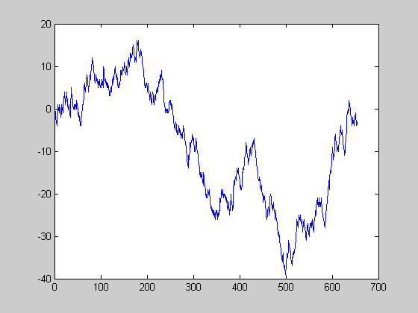
Results for the first strategy
Here, using 10 simulated trading days
If a1=1 and b1>2, we buy at the market
Exit strategy: when b1=1 (then we lose 1 tick) or if we can make a profit, we sell
Results do not show a significant profit (average loss of -0.006 ticks)
MS&E 444 Stochastic model of order book

Slide 13
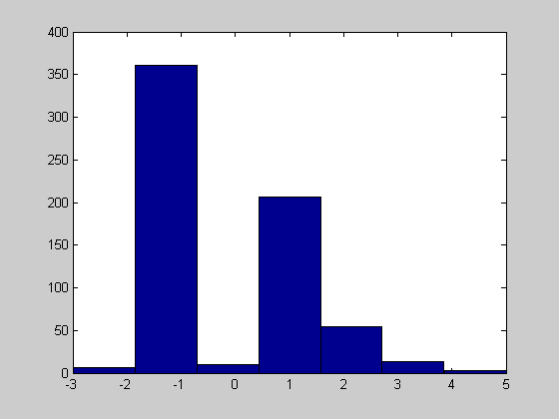
Results for the first strategy
Distribution of the profits for each trade
Changes in the strategy (exit strategy) do not really improve this

Slide 14
Results for the second strategy
Making the spread when the volumes are high at the best bid and the best ask: placing two limit orders and hope they will be both executed
The probabilities are a bit too low (<0.5) except when the volumes are very high (more than five times the average order size) but this doesn’t happen often (less than 0.3% of the time) and there are transaction costs
Results can be improved if for some stocks the arrival rate of market orders is bigger
MS&E 444 Stochastic model of order book

Slide 15
Conclusion
A good model but a few drawbacks (intraday variations, clustering, influence of other stocks…)
A difficult application to real data
But perhaps helpful in order to improve other existing trading indicators
MS&E 444 Stochastic model of order book

Slide 16
Appendix

Slide 17
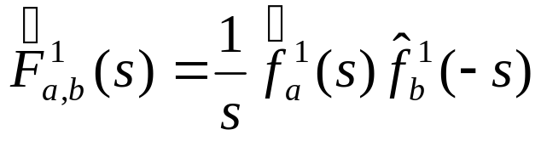
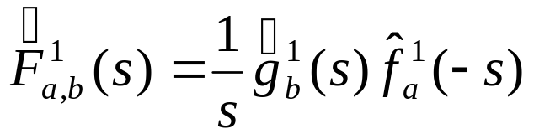
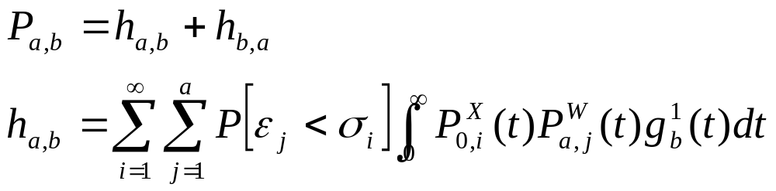
Laplace inversion formula
Probability of increase in mid price (S=1)
Probability of executing an order before the price moves (S=1)
Probability of making the spread (S=1)
MS&E 444 Stochastic model of order book

Slide 18
Monte-Carlo (S=2)
Probability of mid-price increasing =
0.5061 0.4210 0.3811 0.3866 0.3692
0.5923 0.5198 0.4831 0.4625 0.4912
0.6356 0.5485 0.5101 0.5322 0.5216
0.6326 0.5419 0.5047 0.4703 0.5634
0.6387 0.6288 0.5010 0.5127 0.6400
Probability of bid order execution before mid-price changes =
0.1695 0.1905 0.1983 0.1897 0.1945
0.0486 0.0602 0.0570 0.0622 0.0602
0.0162 0.0206 0.0231 0.0236 0.0250
0.0058 0.0093 0.0098 0.0131 0.0119
0.0041 0.0047 0.0057 0.0052 0.0055
MS&E 444 Stochastic model of order book

Slide 19
Laplace inversion (S=2)
Probability of mid-price increasing =
0.4986 0.4041 0.3786 0.3703 0.3670
0.5946 0.4996 0.4706 0.4596 0.4554
0.6200 0.5287 0.4997 0.4885 0.4837
0.6281 0.5392 0.5097 0.5005 0.4950
0.6276 0.5427 0.5173 0.5050 0.5000
Probability of bid order execution before mid-price changes =
0.1502 0.1816 0.1909 0.1942 0.1956
0.0386 0.0522 0.0573 0.0595 0.0605
0.0131 0.0190 0.0218 0.0231 0.0237
0.0053 0.0081 0.0096 0.0104 0.0108
0.0025 0.0039 0.0047 0.0052 0.0055
MS&E 444 Stochastic model of order book

